Slide 1

Approximating Euler’s Number

Slide 2

/* By Jaret Varn, Thomas Laggan, and Zach Pallotta */

Slide 3
Programs
C Python
MPI -Multiprocessing
- Pthreads library
- Open MP

Slide 4
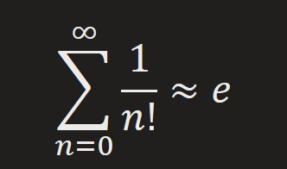
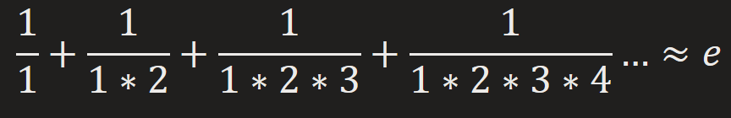
Algorithm
Euler's number can be approximated by summing inverse factorials

Slide 5
Challenges
Workload assignment matters
1, 2, 3, 4, 5 <- Thread 0 (less work)
6, 7, 8, 9, 10 <- Thread 1 (more work)
Large numbers
Factorials get BIG
Unsigned long long int max is 18,446,744,073,709,551,615
22! = 1,124,000,727,777,607,680,000 (already over 60x larger)
Floating point precision
IEEE double can only accurately store 15 decimal places
The sum quickly converges to 15 decimal places of e with only 18 iterations

Slide 6
Comparison Measurements
Runtime Measurements for n = 16000
Speedup Measurements for n = 16000
# of threads | Python (s) | MPI (s) | Pthreads (s) | OpenMP (s)
1 | 1.06e+02 | 1.07e+00 | 1.11e+00 | 1.09e+00
2 | 5.48e+01 | 5.46e-01 | 5.53e-01 | 5.96e-01
4 | 3.24e+01 | 2.77e-01 | 2.81e-01 | 2.96e-01
8 | 2.19e+01 | 1.39e-01 | 1.59e-01 | 1.45e-01
# of threads | Python | MPI | Pthreads | OpenMP
1 | 1.00 | 1.00 | 1.00 | 1.00
2 | 1.94 | 1.95 | 2.00 | 1.83
4 | 3.28 | 3.85 | 3.94 | 3.67
8 | 4.85 | 7.67 | 6.96 | 7.50

Slide 7
Comparison Measurements (cont.)
Efficiency Measurements for n = 16000
# of threads | Python (%) | MPI (%) | Pthreads (%) | OpenMP (%)
1 | 100 | 100 | 100 | 100
2 | 97 | 98 | 100 | 91
4 | 82 | 96 | 99 | 92
8 | 61 | 96 | 87 | 94

Slide 8
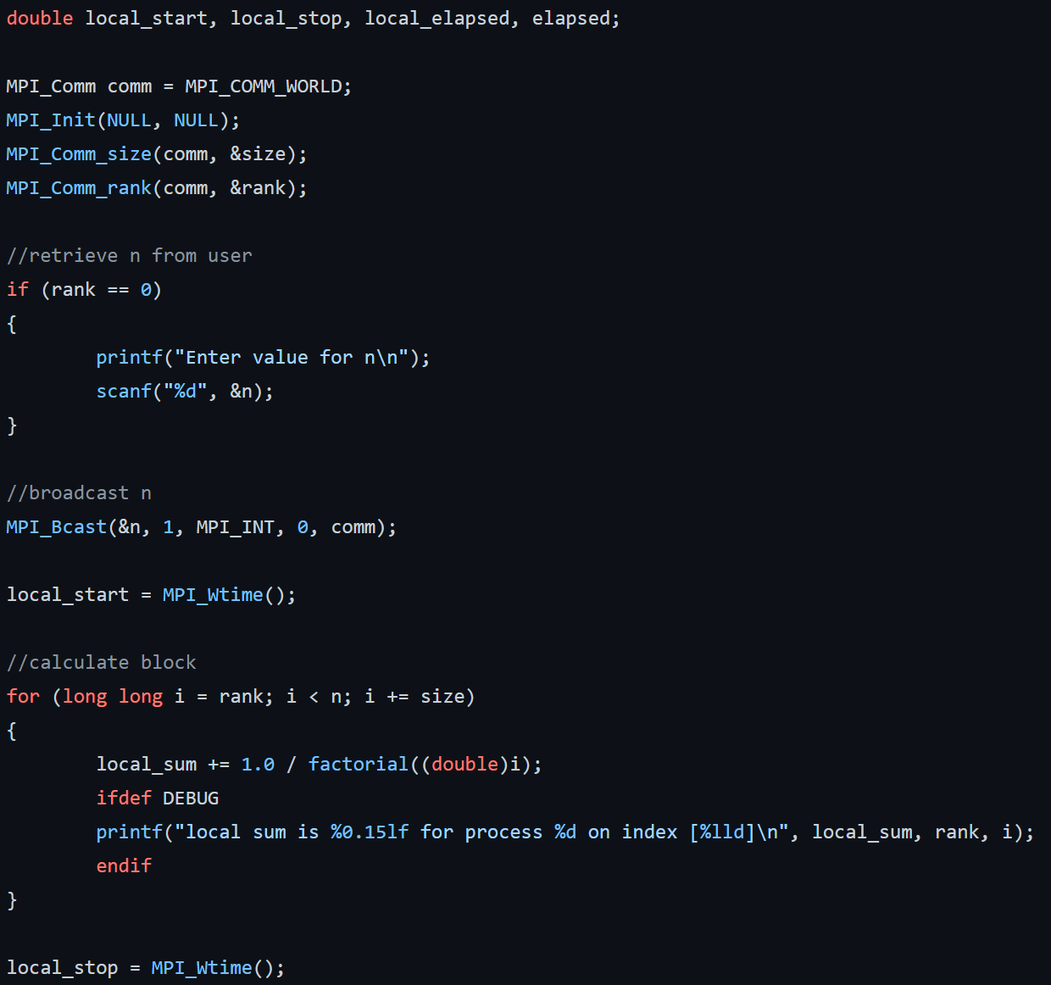
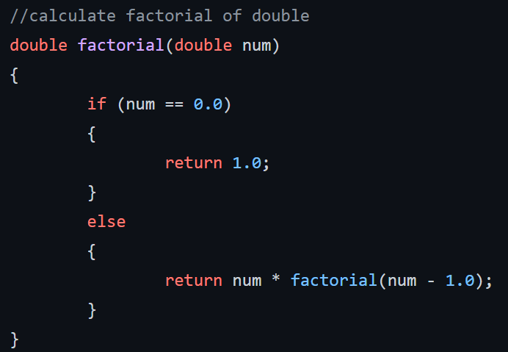
C Code
MPI
Factorial function

Slide 9
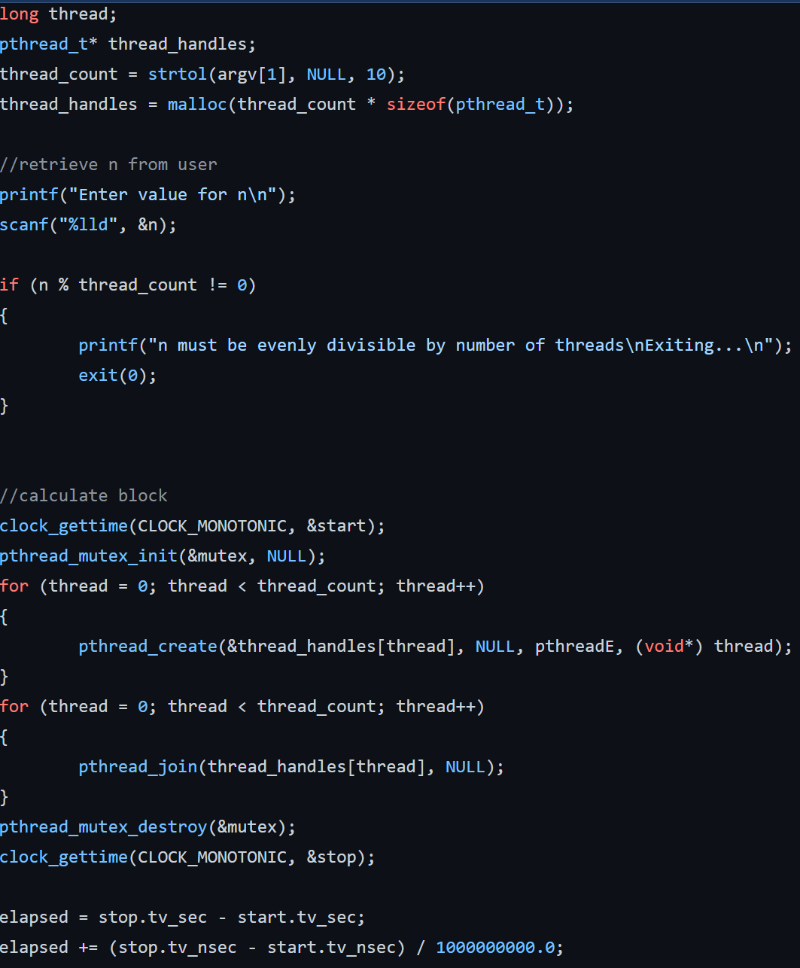
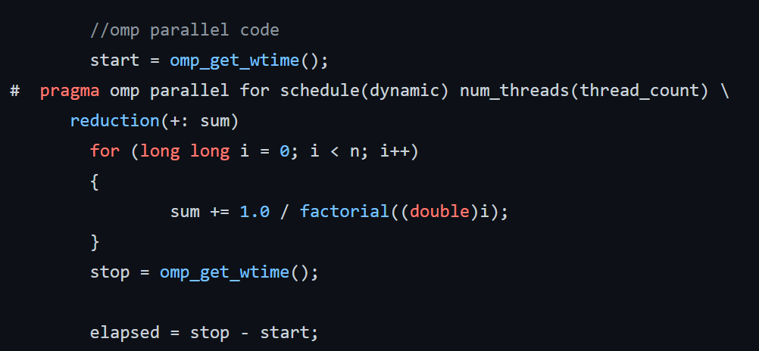
C Code
PThreads
OMP

Slide 10
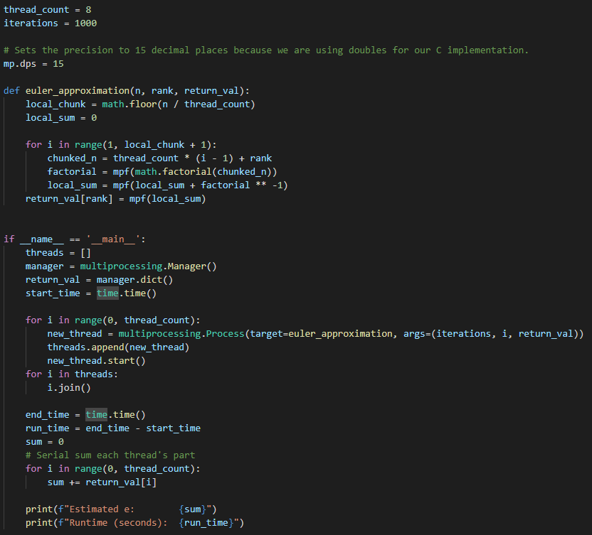
Python
Multiprocessing

Slide 11
Conclusions
All 3 C implementations shared similar scalable performance with near 100% efficiency.
Our C code out-performed Python as expected, with an order of 100x in speed comparison.

